Slide 1
MathMagic: Computational and Mathematical Thinking
Pedro Lealdino Filho
Dr. Christian Mercat
pedro.lealdino@etu.univ-lyon1.fr
christian.mercat@math.univ-lyon.fr

Slide 2
Computational and Mathematical Thinking?
A problem solving processes that includes a number of characteristics and dispositions. They are essential to the development of computer applications, mathematical products, also supporting problem solving across all disciplines.

Slide 3
Computational Thinking
Decomposition: Breaking down data, processes, or problems into smaller, manageable parts.
Pattern Recognition: Observing patterns, trends, and regularities in data.
Abstraction: Identifying the general principles that generate these patterns
Algorithm Design: Developing the step by step instructions for solving this and similar problems.

Slide 4
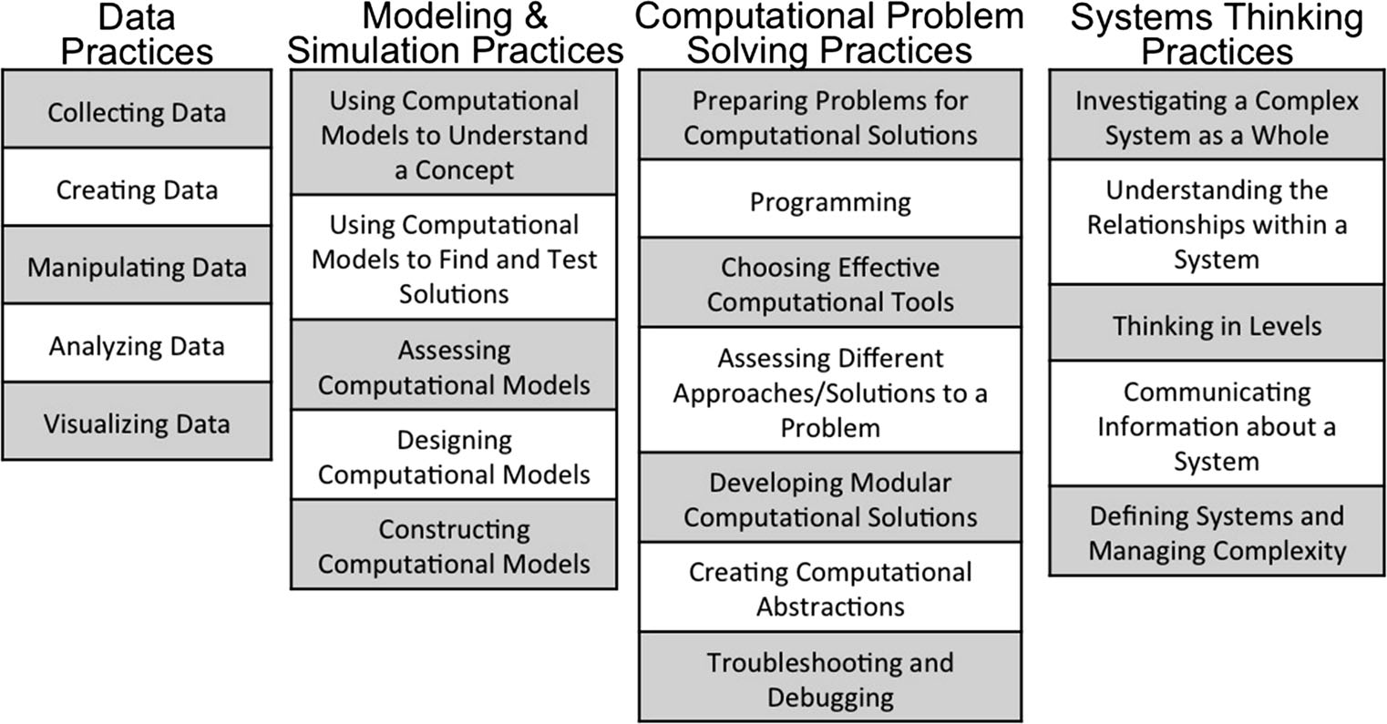
Weintrop, D., Beheshti, E., Horn, M. et al. J Sci Educ Technol (2016) 25: 127. Defining Computational Thinking for Mathematics and Science Classrooms

Slide 5
Mathematical Thinking
Specialising: Trying special cases, looking at examples.
Generalising: Looking for patterns and relationships - Abstraction.
Conjecturing: Predicting relationships and results.
Convincing: Finding and communicating reasons why something is true.

Slide 6
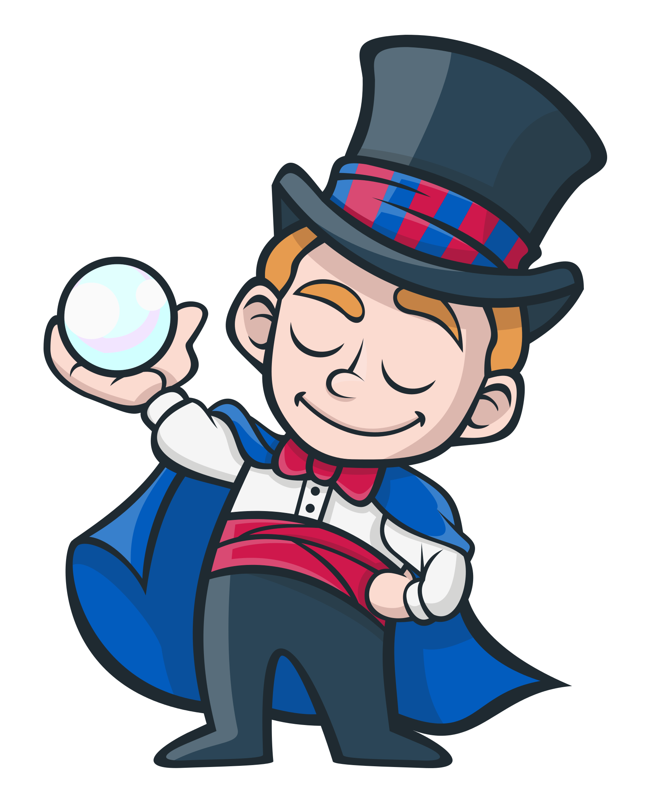
How to develop an algorithm which performs the Mathematical Trick?
I can guess the birthday of a person using five cards.

Slide 7
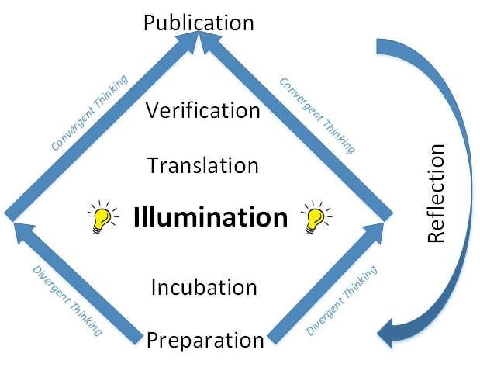
Solving Problem
Understand the problem
Devise a Plan
Carrying out the Plan
Look Back
How to Solve It (Polya, 1945)

Slide 8
Solving the problem:
Let’s use some tools to help us to create the algorithm.

Slide 9
Breaking the Problem - Example:
Let’s say we are using Scratch to develop our first prototype of the Magical Trick. All of sudden you realize that you probably have to use the concept of power.
What’s the new problem?
Is there only one solution?

Slide 10
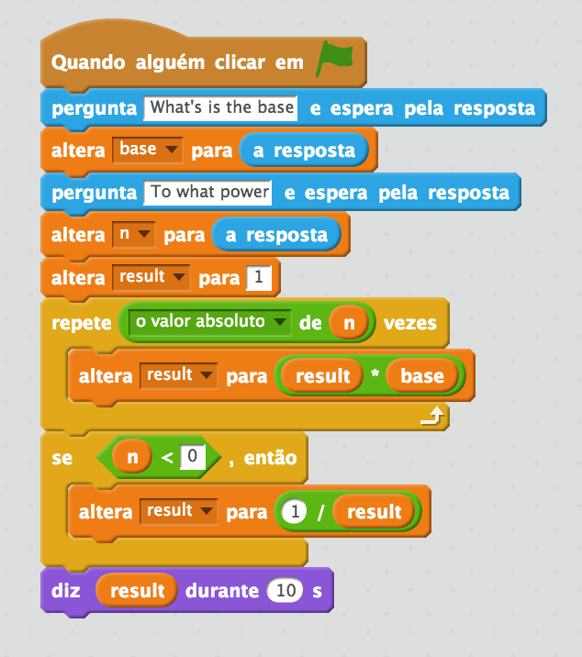
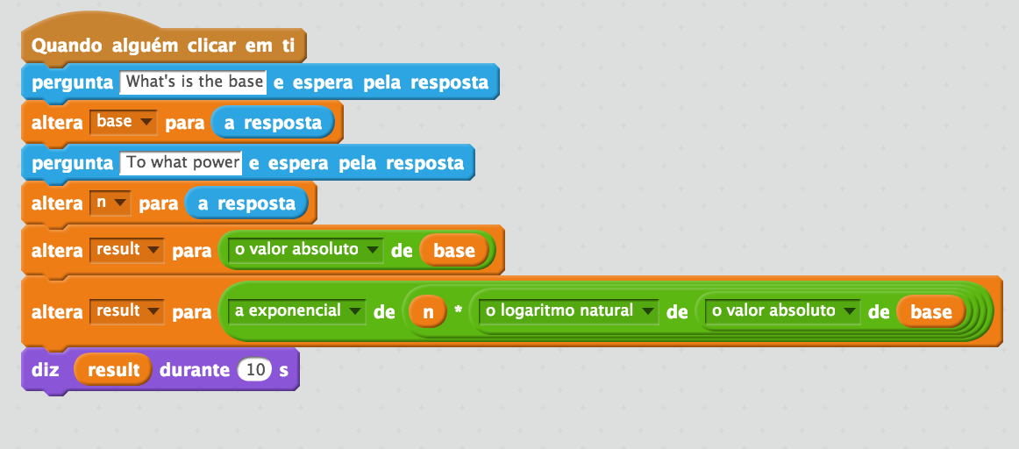

Slide 11
Content
Mathematics: Number - Exploring numbers in other bases. Representing numbers in base two. Mathematics: Algebra - Continue a sequential pattern, and describe a rule for this pattern. Patterns and relationships in powers of two.
Computer Science: Arrays - Storing numbers into an array. Computer Science: Conditional - Taking decisions based in logical expressions. Computer Science: Binary numbers.

